Slide 1
Filling Graphical Shapes
Dr. Subhadip Basu
CSE Dept., JU
Subhadip.basu@jadavpuruniversity.in

Slide 2
We know how to draw outlines
Can we just fill the “inside”?
…but how do we know the difference between the inside and outside?
  Can we determine if a point is inside a shape?

Slide 3
A Filling Anomaly

Slide 4
One Approach:
The Odd-Even Rule
0
Choose an arbitrary point
Draw ray to a distant point
  Don’t intersect any vertices
  What’s a “distant” point?
Count edges crossed
  Odd count means interior
  Even count means exterior
1
2
3
1
1
2

Slide 5
Odd-Even Result
1
2
1
3
1
1

Slide 6
Another approach:
Nonzero Winding Rule
Choose a point
Draw ray to a distant point
  Don’t intersect any vertices
Consider edges crossed (right hand rule)
  Subtract 1 when ray to edge is clockwise
  Add 1 when ray to edge is counter-clockwise
Nonzero count means interior
  Count = “Winding number”
0
-1
-2
-1
-1
-1
0

Slide 7
Nonzero Winding Example
−1
−2
−1
−1
−1
−1

Slide 8
Filling Graphical Shapes
Part - 2

Slide 9
We know two approaches for inside/outside determination
Odd-even rule
  “Alternate” rule in MS API documentation
Non-zero winding rule

Slide 10
So how do we employ these rules?
  Scan-Line Polygon Fill Algorithm

Slide 11
The Scan Line Approach
Scan Line
the rasterized line segment that forms a horizontal slice of the image

Slide 12
Fills one scan line at a time using either the Odd/Even or Non-Zero Winding rule
Assumption:
The polygon region is closed: image has edge pixels on each scan line ()
Requirement
ray/edge intersection points can be calculated
  from polygon edge & ray equations
E2
E3
p
E1
E4
E6
E5

Slide 13
For each scan line
  Start outside (U.L. of bounding rectangle)
  Scan line from left to right
  Determine the intersection with all boundaries
  Sort the intersection points
  At each intersection, compute in/out

Slide 14
For each scan line
  Start outside (U.L. of bounding rectangle)
  Scan line from left to right
  Determine the intersection with all boundaries
  Sort the intersection points
  At each intersection, toggle in/out-ness
What about this?

Slide 15
Parametric Line equations – one way to determine intersections
For line E from (x₁,y₁) to (x₂,y₂)
    x = x₁ + (x₂ – x₁)*t, t ∈ [0,1]
    y = y₁ + (y₂ – y₁)*t
For a line p from (x₃,y₃) to (x₄,y₄)
    x = x₃ + (x₄ – x₃)*u, u ∈ [0,1]
    y = y₃ + (y₄ – y₃)*u
E
p

Slide 16
Parametric Line equations
At the intersection
    x₃ + (x₄ – x₃)*u = x₁ + (x₂ – x₁)*t
    y₃ + (y₄ – y₃)*u = y₁ + (y₂ – y₁)*t
2 equations, 2 unknowns (u and t)

Slide 17
Exercise
At the intersection
    x₃ + (x₄ – x₃)*u = x₁ + (x₂ – x₁)*t
    y₃ + (y₄ – y₃)*u = y₁ + (y₂ – y₁)*t
    x₁ = 100, y₁ = 100
    x₂ = 200, y₂ = 200
    x₃ = 150, y₃ = 150
    x₄ = 200, y₄ = 150
  What are u and t at the intersection?
2
E
3
p
4
1

Slide 18
Vertex Complications
1 intersection
2 intersections
What is the difference between these cases?

Slide 19
Vertex Intersection Types
No change
Inside/outside change
Check monotonicity of adjacent edges

Slide 20
Horizontal edge situation
Ignore horizontal segments (but don’t fill over them)
Check monotonicity of adjacent edges

Slide 21
Calculating Intersections is expensive
All edge intersections must be computed for every scan line
Alternate: Coherence
  For linear segments
    Each scan line is similar to previous
    Intersections can be calculated incrementally

Slide 22
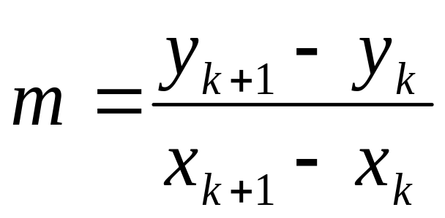
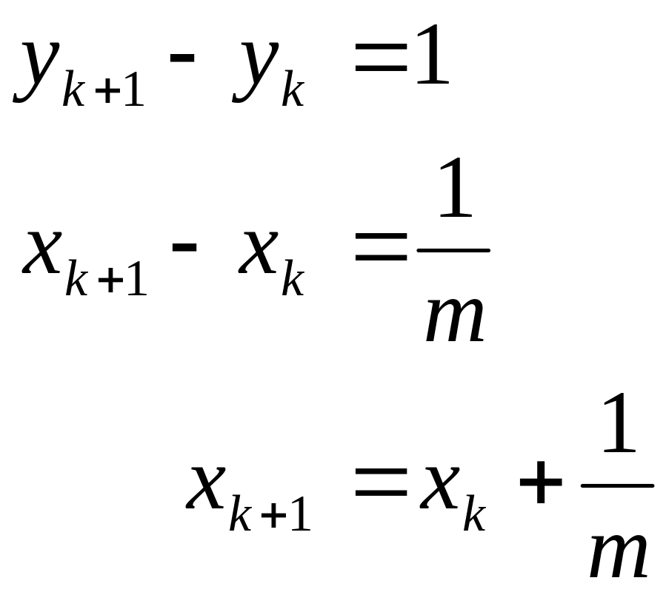
Incremental Calculation

Slide 23
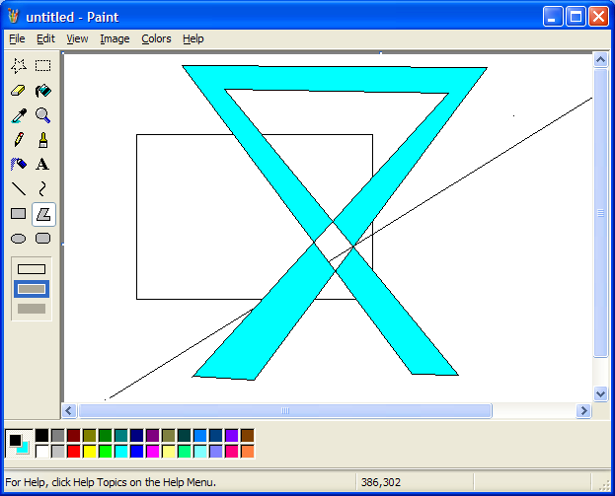
Scanline fill
MS Paint example

Slide 24
Filling Graphical Shapes
Pixel-based methods

Slide 25
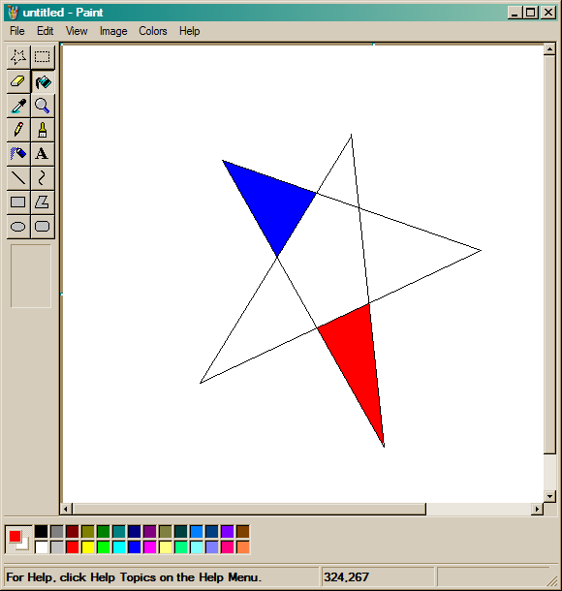
Boundary Fill
MS Paint

Slide 26
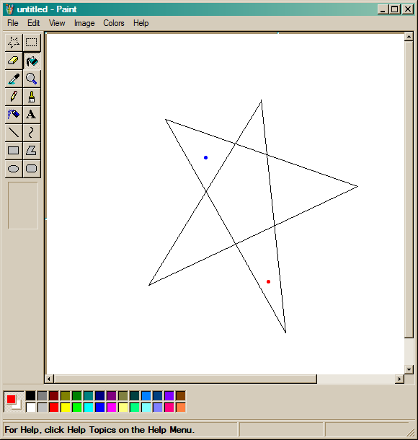
Boundary Fill
Start at interior point
“Paint” interior outward toward boundary
  How?
  Note: Boundary encounter determined by boundary pixel color

Slide 27
Boundary fill
Interior point

Slide 28
Boundary Fill Algorithm
Don’t fill if current position is:
  Boundary color
  Current fill color
Otherwise
  Set fill color
  Recursively try neighbors
    North, East, South, West
    Could also be NSEW, NEWS, etc.
    Each neighbor recursively performs algorithm until “stop”

Slide 29
Boundary Fill Patterns
4-connected
8-connected

Slide 30
4-connected
EWNS boundary fill

Slide 31
Boundary Fill Algorithm (cont.)
void BoundaryFill4(int x, int y,
color newcolor, color edgecolor)
{
int current;
current = ReadPixel(x, y);
if(current != edgecolor && current != newcolor)
{
BoundaryFill4(x+1, y, newcolor, edgecolor);
BoundaryFill4(x-1, y, newcolor, edgecolor);
BoundaryFill4(x, y+1, newcolor, edgecolor);
BoundaryFill4(x, y-1, newcolor, edgecolor);
}
}

Slide 32
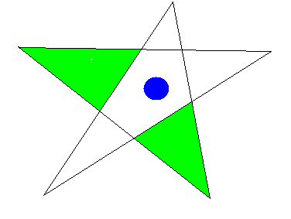
Boundary Fill Problems
Recursive algorithm
  Stack space issue
Recursion stops only on
  Boundary color
  Current fill color
What if some other fill color is already present?
  i.e. pixels already in area to be filled

Slide 33
Flood Fill
Similar to boundary fill
But replaces “interior” color (i.e. not boundary)
  Floods through an area
  Fill area must be - initially – a consistent color
  Only one significant color is filled over
Paint bucket tool
  MS Paint actually uses flood fill

Slide 34
Flood Fill Algorithm (cont.)
void FloodFill4(int x, int y, color newcolor, color oldColor)
{
if(ReadPixel(x, y) == oldColor)
{
FloodFill4(x+1, y, newcolor, oldColor);
FloodFill4(x-1, y, newcolor, oldColor);
FloodFill4(x, y+1, newcolor, oldColor);
FloodFill4(x, y-1, newcolor, oldColor);
}
}

Slide 35
Fill Algorithm Summary
Vector edge model
  Scan line fill
    Even-odd or non-zero winding
Pixel model
  4- or 8- connected recursion
  Boundary fill: overwrites all but boundary or current fill color
  Flood fill: overwrites only initially selected color

Slide 36
Printing
How do we simulate intermediate shades of grey in an 8-bit image?
How can we use small number of coloured inks to simulate the huge range of colours possible in a 24-bit image?

Slide 37

Printing Grayscale Images
Problem: How to print a gray-scale image when the only color ink available is black (the ink) and white (the paper)?
  This is the problem faced by newspapers and any other print media.
    Newspapers print at 80-100 DPI (dots per inch)
    Magazines print at 200-300 DPI
  Color printing is a more complicated variant of this problem.
  The solution is to use a technique known as halftoning.
    The process of generating binary pattern of black and white dots from an image.

Slide 38
Halftoning
Photographs are images with continuous shades of black, white, and gray. These shades are tones.
Halftoning is a technique, originally developed for the printing industry, to reproduce continuous tone images using printing techniques capable of black and white only, not shades of gray.

Slide 39
Need for Digital Image Halftoning
Introduction
Examples of reduced grayscale/color resolution
  Laser and inkjet printers ($9.3B revenue in 2001 in US)
  Facsimile machines
  Low-cost liquid crystal displays
Halftoning is wordlength reduction for images
  Grayscale: 8-bit to 1-bit (binary)
  Color displays: 24-bit RGB to 12-bit RGB (e.g. PDA/cell)
  Color displays: 24-bit RGB to 8-bit RGB (e.g. cell phones)
  Color printers: 24-bit RGB to CMY (each color binarized)
Halftoning tries to reproduce full range of gray/ color while preserving quality & spatial resolution.

Slide 40
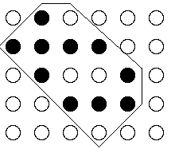
Halftoning
The process of transforming a grayscale image to a halftone.
Create the illusion of gray-scale by varying the average dot density in local regions of the image
Dots are always something that can be counted and it must be possible to hold a measuring stick to them.
Takes advantage of the fact that the eye integrates intensity of small image regions.
Sacrifices spatial resolution for gray-scale resolution (unless the output device can be over-sampled as most ink-jet printers are these days)
Spatial refers to image itself, based on direct manipulation pixels.

Slide 41
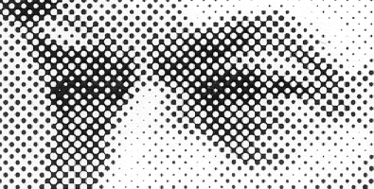
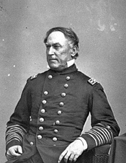

Halftoning
Consider a grayscale image (left) which is halftoned (right) for printing. The right image looks like a grayscale image but is actually only black and white!
Zooming in on the image reveals “pixel” sizes of differing sizes and shapes.

Slide 42
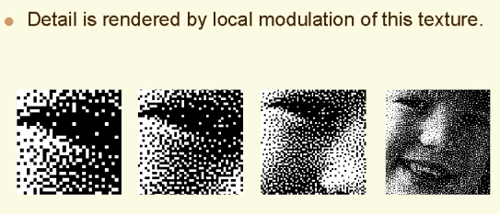
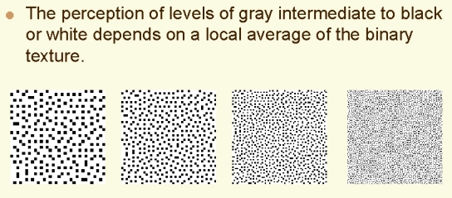
Halftoning

Slide 43
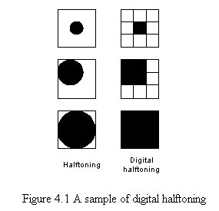
Digital Halftoning
The previous example is from the domain of print media which uses physical filters, lights, and film to generate the halftoned images.
Digital halftoning cannot be done this way since digital images consist of identically shaped pixels (usually rectangular) which are either black or white.
The main problem is “Should this pixel be white or black”?
Possible solution to this problem
    Bi-level Thresholding

Slide 44
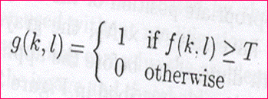

Bilevel Thresholding
Re-quantize the image using a 1 bit color
If the gray-level of a pixel is less than some threshold value then set the output to black otherwise set the output to white.
  The threshold value may be the “center of the available gray-scale range”
  The threshold value may by the “average of all pixels in the image”
The T value can be choosen e.g inspecting the histogram image f.
or

Slide 45
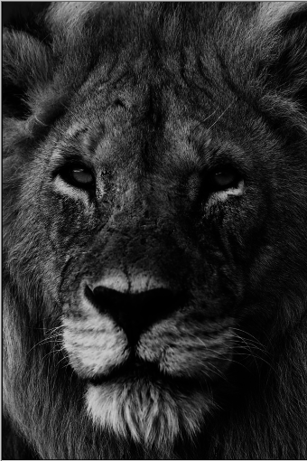
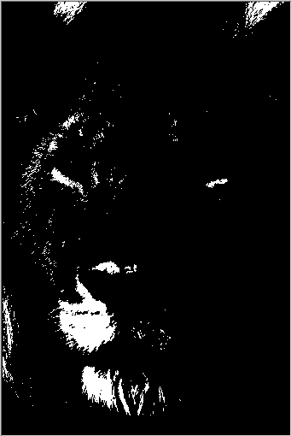
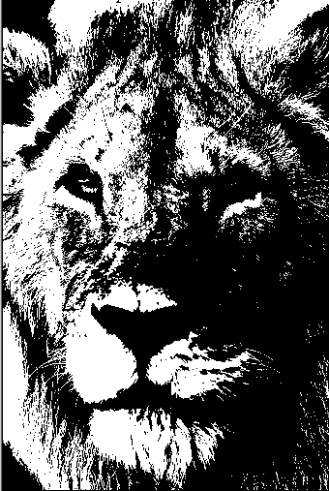
Bi-level Thresholding Example
Original Image
Absolute Threshold
Adaptive Threshold

